Slide 1
Monitoring Forest Recreation in Vermont
William Valliere
Nathan Reigner
Robert Manning
Park Studies Laboratory
Rubenstein School of Environment and Natural Resources
University of Vermont
Jessica Savage
Vermont Department of Forests, Parks and Recreation

Slide 2
Motivations → Benefits
Motivations
Proficiency
Physical challenge
Escape
Intimacy with nature
Reenaction of primitive life
F
Benefits
Self esteem
Health & strength
Refreshment & rejuvenation
Connection & knowledge
Seeking Solitude
Reflection & Rejuvenation

Slide 3
Activity & Setting
Setting
Rural → Primitive
Place qualities
F È |
© l [
T 5 9
Activities
Motivations
Benefits
Solitude
Hike in a State Park
Reflection

Slide 4
Multiple Dimensions of Recreation
Resource
Trail Impacts
Social
Trail Encounters
Managerial
Facilities & Development
Motivations
Activities
Benefits
Setting
Solitude
Hike in a State Park
Reflection

Slide 5
Use – Impact – Quality

Slide 6
Use – Impact – Quality
Impact
Y2
Y1
X1
X2
Use

Slide 7
Objective Based Management
Objective
Indicators
Monitoring
Standards

Slide 8
Objective Based Management
Objective
  Defines quality
  Desired conditions
Indicator
  Proxy(ies) for objective
  Sensitive to use
    Measurable
    Manageable

Slide 9
Activities
Setting
Motivations
Resource – Social – Managerial
Benefits
Objective
Indicator
Objective: Solitude Indicator: Trail encounters LAC:
Solitude
Hike in a State Park
Reflection

Slide 10
Objective Based Management
Standards
  plural Levels of quality
  singular Minimum acceptable condition
  Limit of acceptable change
What quality do we want?
How much use?
LAC
Standards of Quality
Indicator

Slide 11
Objective Based Management
Solitude
# of Encounters
Monitor
5/day

Slide 12
Monitoring
Objective
Indicators
Monitoring
Standards

Slide 13
Relationships & Conditions
Impact
Y2
Y1
X1
X2
Use

Slide 14
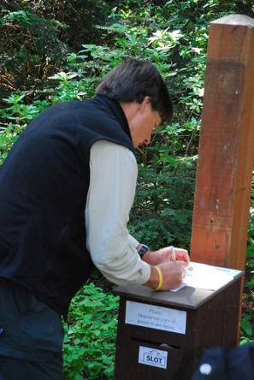
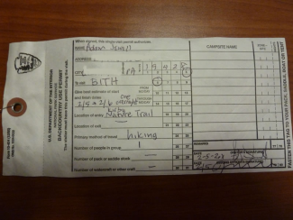
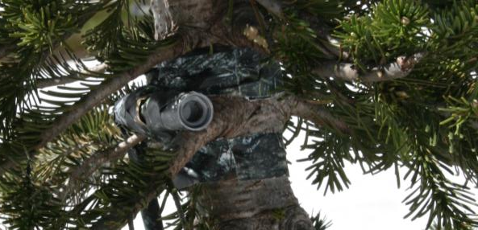
Basic Techniques
Registers
Permits
Surveys
Counters

Slide 15
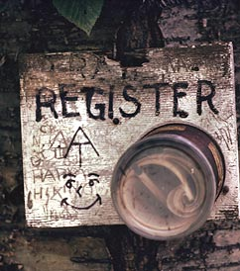
Registers & Permits
Basic Information
  Volume of use
  Residence of users
  Group sizes
  Destination
  Anecdotal
Registers are…
  Self-reported
  Specific groups excluded

Slide 16
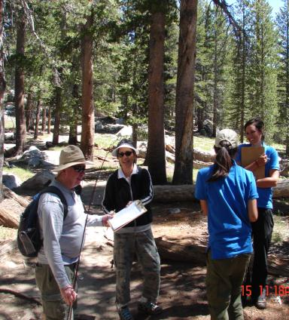
Surveys
On or Off Site
Sampling Plan?
Users, Activities, Trips
Perceived Conditions
Management Acceptability
Public Input/User Perspective
Challenges
  Burden, Self-Reported, Recruitment

Slide 17
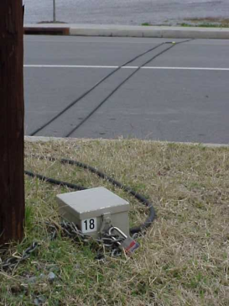
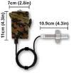
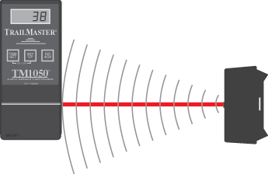
Counters
Road, Parking lot, Trail
Placement
Data management
Calibration
Counters provide an estimate of real volume

Slide 18

Trail Counter
Placement
Constriction
Close
Core
Clarity
Specificity
Concealment

Slide 19

Trail Counter
Placement
Constriction
Close
Core
Clarity
Specificity
Concealment

Slide 20
Trail Counter
Placement
Constriction
Close
Core
Clarity
Specificity
Concealment

Slide 21
Trail Counter
Placement
Constriction
Close
Core
Clarity
Specificity
Concealment

Slide 22
Trail Counter
Placement
Constriction
Close
Core
Clarity
Specificity
Concealment

Slide 23
Trail Counter
Placement
Constriction
Close
Core
Clarity
Specificity
Concealment

Slide 24
Trail Counter
Placement
Constriction
Close
Core
Clarity
Specificity
Concealment

Slide 25
Trail Counter
Placement
Constriction
Close
Core
Clarity
Specificity
Concealment

Slide 26
Trail Counter
Placement
Constriction
Close
Core
Clarity
Specificity
Concealment

Slide 27
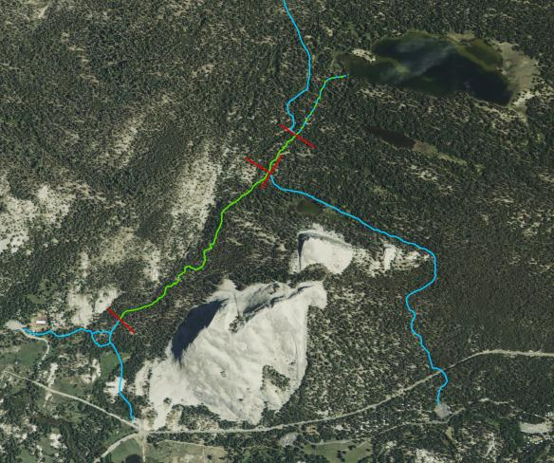
Trail Counter
Placement
Constriction
Close
Core
Clarity
Specificity
Concealment

Slide 28
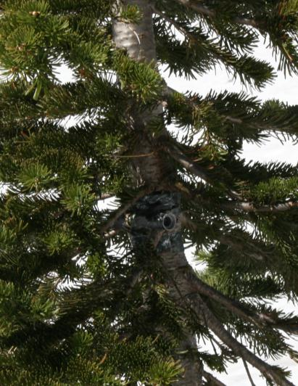
Trail Counter
Placement
Constriction
Close
Core
Clarity
Specificity
Concealment

Slide 29
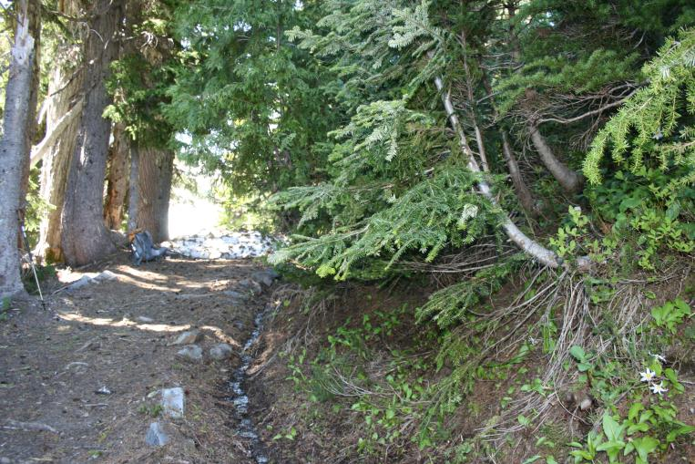
Trail Counter Placement

Slide 30
Trail Counter Placement

Slide 31
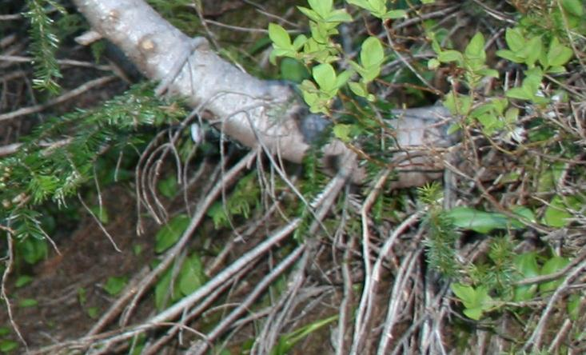
Trail Counter Placement

Slide 32
Trail Counter Placement

Slide 33
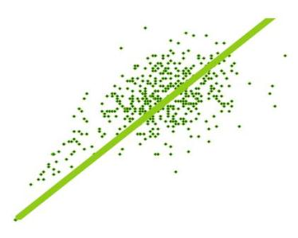
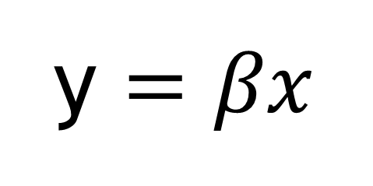
Intermediate Techniques
Regression Modeling
  Calibration
  Site to Site Prediction
Reality
Counter
y $=βx$

Slide 34
Counter Calibration
Estimate
  1 count
Reality
  2 individuals

Slide 35
Counter Calibration
Estimate
  2 counts
Reality
  1 individual

Slide 36
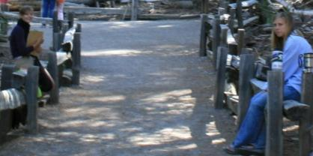
Counter Calibration
Estimate
  Counter
Reality
  Observer

Slide 37
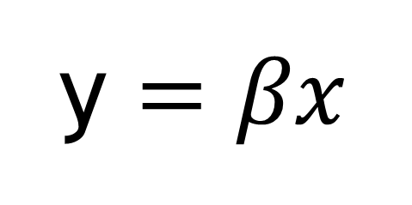
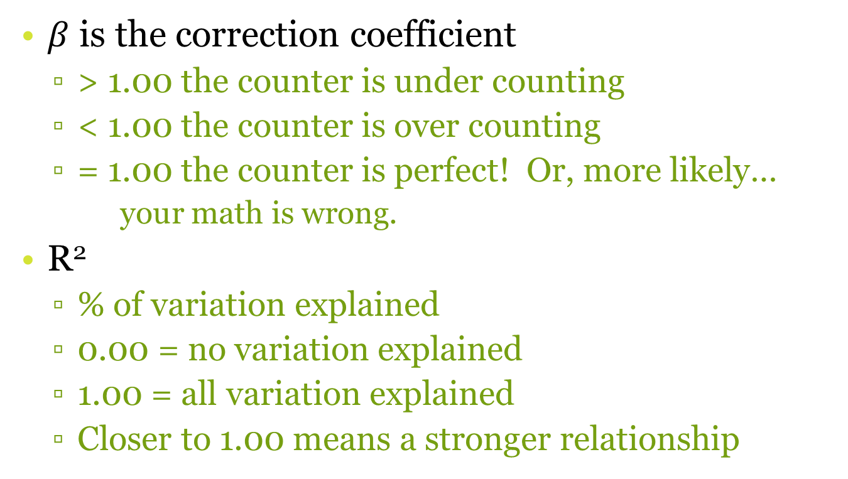
Counter Calibration
y $=βx$
$β$ is the correction coefficient
  > 1.00 the counter is under counting
  < 1.00 the counter is over counting
  = 1.00 the counter is perfect! Or, more likely…
    your math is wrong.
R²
  % of variation explained
  0.00 = no variation explained
  1.00 = all variation explained
  Closer to 1.00 means a stronger relationship

Slide 38
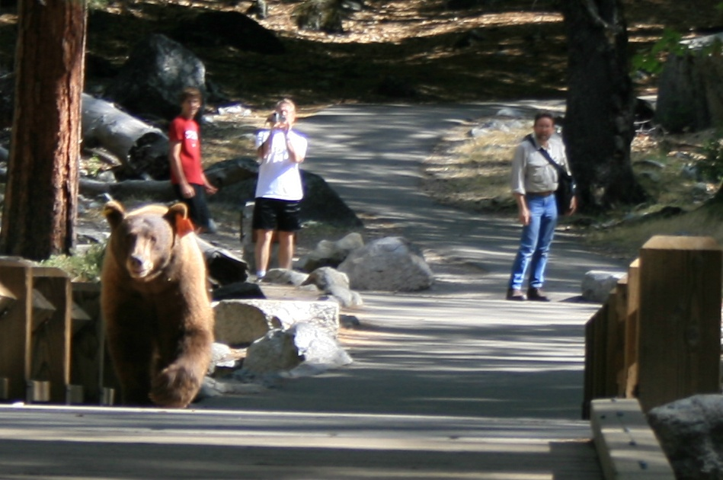
Questions about monitoring?

